Slide 1

π
Document Loaders
May 2024
π

Slide 2

π
Tools We will cover?

Slide 3
π
Document Loaders
Document Loader
TextLoader
PyPDFLoader
DirectoryLoader
Lazy_Loader
WebBaseloader
CSVLoader
langchain_community.document_loaders
π

Slide 4
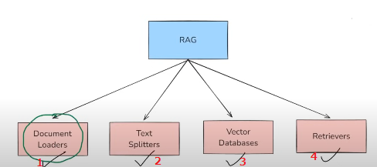
π
Document Loaders
Reliability and Accuracy

Slide 5
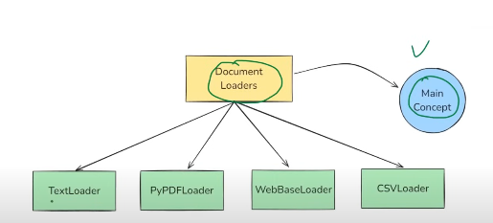
π
langchain_community
Document loaders resides in langchain_community
Notes:
Content: https://www.linkedin.com/pulse/chunking-strategies-ai-data-kash-kashyap-0lghe/

Slide 6
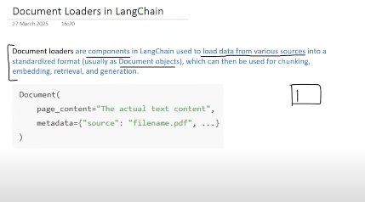
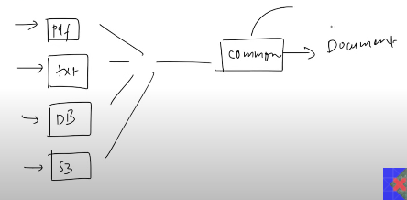
π
document loader is a component in langchain that is used to load data from various sources(text,pdf,html etc) into standardized document oject
sp that other compnet in langhcian can integated eaisly
Notes:
Content: https://www.linkedin.com/pulse/chunking-strategies-ai-data-kash-kashyap-0lghe/

Slide 7
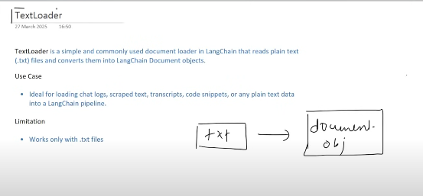
π
Notes:
Content: https://www.linkedin.com/pulse/chunking-strategies-ai-data-kash-kashyap-0lghe/

Slide 8
π
from langchain_community.document_loaders import TextLoader
loader=TextLoader("cricket.txt", encoding="utf8")
docs=loader.load()
print(docs[0].page_content)
print(docs[0].metadata)
Notes:
Content: https://www.linkedin.com/pulse/chunking-strategies-ai-data-kash-kashyap-0lghe/

Slide 9
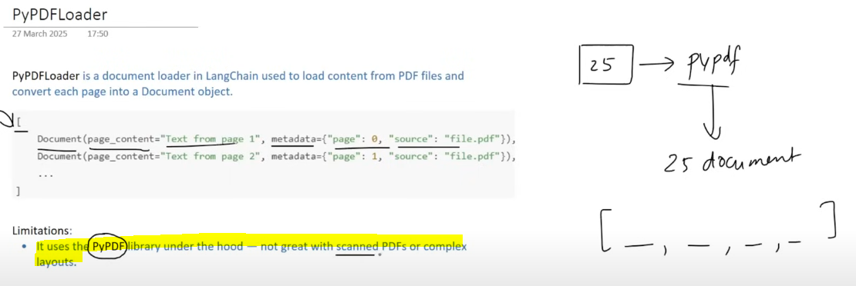
π
Notes:
Content: https://www.linkedin.com/pulse/chunking-strategies-ai-data-kash-kashyap-0lghe/

Slide 10
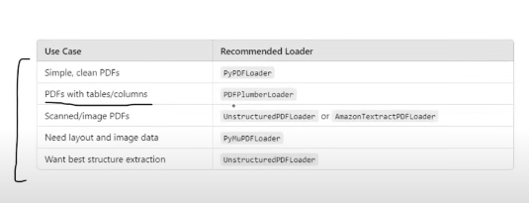
π
langchain havae many PDFLoader.But PyPDFLoader mostly used when have mainly Textual Data
XXX -pyPDFloader not work perfectly with scan images
Notes:
Content: https://www.linkedin.com/pulse/chunking-strategies-ai-data-kash-kashyap-0lghe/

Slide 11
π
from langchain_community.document_loaders import PyPDFLoader
loader=TextLoader("dl-curriculum.pdf”)
docs=loader.load()
print(docs[0].page_content)
print(docs[0].metadata)
Notes:
Content: https://www.linkedin.com/pulse/chunking-strategies-ai-data-kash-kashyap-0lghe/

Slide 12
π
Notes:
Content: https://www.linkedin.com/pulse/chunking-strategies-ai-data-kash-kashyap-0lghe/

Slide 13
π
Notes:
Content: https://www.linkedin.com/pulse/chunking-strategies-ai-data-kash-kashyap-0lghe/

Slide 14
π
Notes:
Content: https://www.linkedin.com/pulse/chunking-strategies-ai-data-kash-kashyap-0lghe/

Slide 15
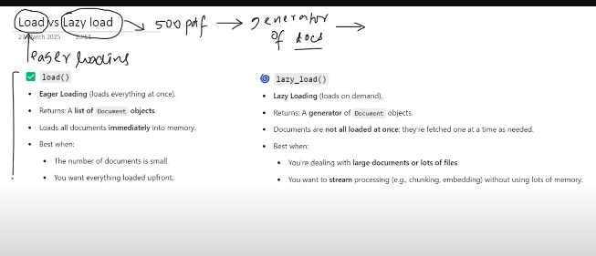
π
Notes:
Content: https://www.linkedin.com/pulse/chunking-strategies-ai-data-kash-kashyap-0lghe/

Slide 16
π
Notes:
Content: https://www.linkedin.com/pulse/chunking-strategies-ai-data-kash-kashyap-0lghe/

Slide 17
π
Notes:
Content: https://www.linkedin.com/pulse/chunking-strategies-ai-data-kash-kashyap-0lghe/

Slide 18
π
Notes:
Content: https://www.linkedin.com/pulse/chunking-strategies-ai-data-kash-kashyap-0lghe/

Slide 19
π
Notes:
Content: https://www.linkedin.com/pulse/chunking-strategies-ai-data-kash-kashyap-0lghe/

Slide 20
π
Notes:
Content: https://www.linkedin.com/pulse/chunking-strategies-ai-data-kash-kashyap-0lghe/

Slide 21

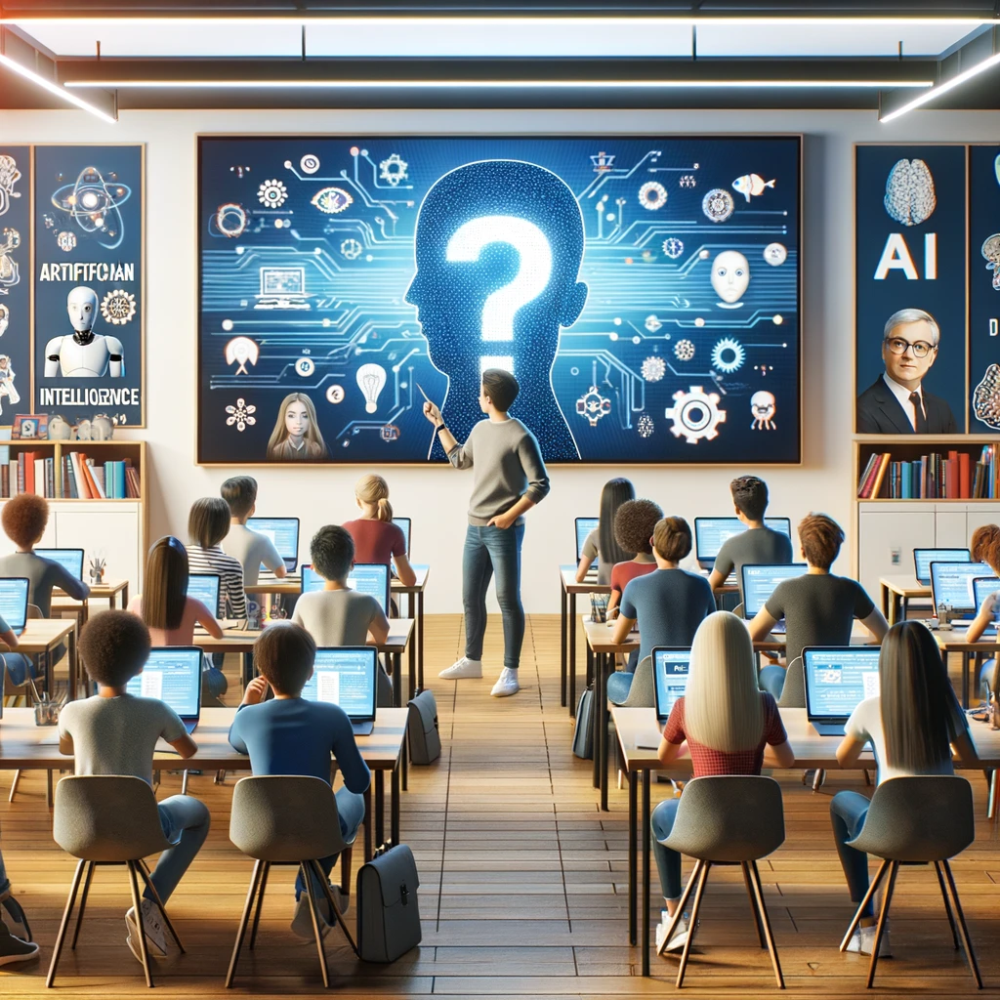
π
Q & A

